Slide 1

DAYANANDA SAGAR COLLEGE OF ENGINEERING Shavige Malleshwara Hills, Kumaraswamy Layout, Bangalore-560078 (An Autonomous Institute affiliated to VTU, Approved by AICTE &ISO 9001: 2008 Certified) Accredited by National Assessment & Accreditation Council (NAAC) with ‘A’ Grade Department of Mechanical Engineering
Batch Number 19
Major Project Final - Presentation
Title: "Optimization and Characterization of Fused Deposition Modelling (FDM) Parameters for Enhanced Mechanical Properties in 3D Printed material for Biomedical application"
Guide Name | Dr. VIVEK BHANDARKAR. V. N
Designation | Asst. Professor
Student Name | Mallanna | Naveenakumar Annennanavar | Rakesha K P | Sudarshan N D
USN | 1DS20ME044 | 1DS20ME420 | 1DS21ME455 | 1DS21ME478

Slide 2
Sl. No. | CONTENTS | Slide No.
1. | Abstract | 3
2. | Introduction | 4
3. | Literature survey | 6
4. | Objectives | 9
5. | Flow chart | 10
6. | Specification | 11
7. | 3 D Printing | 13
8. | Modelling | 14
9. | Experimentation | 18
10. | Results and Discussions | 22
11. | Total cost of the Project | 30
12. | Applications | 31
13. | Project outcomes | 32
14. | References | 33

Slide 3
Abstract :
Additive manufacturing (AM) is the procedure in which parts are fabricated in a layer-by-layer manner, exactly the opposite of conventional manufacturing, in which material is removed. Nowadays, additive manufacturing is usually preferable over traditional manufacturing methods owing to its better accuracy, less time for manufacturing, lower cost, and good quality of products.
In Fused Deposition Modeling (FDM) three-dimensional (3D) printed part is greatly affected by the process parameters, therefore the parameters have to select properly to enhance the characteristics of the final product. The fused deposition modelling (FDM) technique is widely used to produce components for various applications and has the potential to revolutionize orthopaedic research through the production of custom-fit and readily available biomedical implants. The properties of FDM-produced implants are significantly influenced by processing parameters, with layer thickness being a crucial parameter. The effect of these parameters will be studied on tensile strength and flexural strength , experimentally and statistically.
The building parameters of three-dimensional (3D) printed composite bone plates will be optimized by an orthogonal experiment, and the effects of the layer thickness, printing speed, filament feeding speed, and biomedical content on the bending strengths and tensile strength of the specimens will be analysed. Based on Taguchi’s mixed model fractional factorial design(L27), experiments will be set and the specimens are printed on FDM 3D printer and tested for tensile strength and flexural strength. Thereafter, the optimal combination of the parameters will be selected using Signal-to-Noise ratio (S/N), and Analysis of Variance (ANOVA) is used for indicating the significant parameters and their effect on tensile strength and flexural strength.

Slide 4
Introduction:
Contrary to subtractive manufacturing, additive manufacturing (AM), often known as 3D printing, is a method of fabricating items by connecting data from 3D models, and it is typically carried out layer by layer. The design and manufacturing processes can be improved in terms of speed and flexibility due to this technology. Additionally, traditional manufacturing methods need a lot of time and money to generate complex shapes, therefore 3D printing machines are employed in many industries to create custom parts during the design phase. However, this technology's rapid progress resulted in the production of end-use components. The 3D printing technique can reduce wasteful material use, labor-intensive processes, and production costs. The final product's shape is set by a computer-aided design (CAD) file in this method, making design modification a effortless procedure. A important element of the fourth industrial revolution that reduces physical movement is 3D printing.
Numerous industries, including those in the automotive, aerospace, medical, food, clothing and fashion, electric and electronic, educational, prototype, architectural, chemical, building, and construction sectors, have applications in 3D printing technology. FDM, fused filament fabrication (FFF), stereolithography (SLA), direct jetting, photopolymer jetting, selective laser sintering (SLS), laser melting, electron beam melting, and hybrid processes are a few categories of AM. FDM technology is the most well-known of these 3D printer technologies since it is simple, affordable, and has a wide variety of commercially available raw materials. It can be used as a machine for continuous production and provides flexibility and friendliness in processing and material handling.

Slide 5
Introduction:
Utilizing additive manufacturing (AM) in orthopedics represents a primary application of this technology in the medical field, with a notable focus on personalized implants through 3D printing. Orthopedic implants include a range of applications, including trauma implants (such as plates and screws), spinal implants (e.g., artificial vertebral bodies and cages), joint implants (e.g., artificial hip and knee joints), as well as customized prostheses (e.g., scapular, chest, and rib prostheses), and scaffolds for bone tissue engineering.
Polylactic acid (PLA), a promising polymer due to its high biocompatibility and biodegradability, finds application in various biomedical contexts, including the creation of degradable scaffolds, bone plates, and other implants. However, non-degradable bone plates, made from materials like PLA, often require removal post-fracture healing, subjecting patients to additional surgeries. To address this, researchers have explored composite materials, incorporating bio ceramic particles like hydroxyapatite (HA), Polyether ether ketone (PEEK), Polyethylene terephthalate glycol (PETG). These enhances implant biocompatibility, bone integration, and creates a slightly alkaline environment during degradation, reducing the risk of aseptic inflammation.

Slide 6
Literature survey :
1. Balwant Singh et. al., Through a comprehensive literature review, this research attempted to identify the various Polymer Matrix Composite (PMC) materials utilised in 3D printing. This study investigates the mechanical properties and other properties of composites created using 3D printing processes. And also, the influence of various composite materials and production procedures on mechanical characteristics has been compared. Hybrid materials can be employed to improve the end product's mechanical, tribological, and morphological qualities. The findings might serve as a model for future researchers interested in composite material development.
2. Xin Wang et. al., conducted research on polymer composite material 3D printing techniques such as fused deposition modelling, selective laser sintering, inkjet 3D printing, stereolithography, and 3D plotting. The technology for creating and performing particle, fiber, and nanomaterial-reinforced polymer composites is highlighted. They demonstrated the printability of the glass fibre and carbon fibre composite compositions created in this study using 3D models. They have also discussed potential applications in biomedical, electronics, and aerospace engineering.

Slide 7
3. Yahia Halabi et all, experimentally studied the process parameters namely fiber tensile strength, polymer tensile strength, layer thickness, fiber volume fraction, fiber form, infill pattern, and fiber orientation. MATLAB software was used to codify and implement the ABC algorithm and ANN modelling technique. The results shows that good accuracy of this model, R2 values for training, validation, and testing datasets were 0.96, 0.90, and 0.90, respectively; while the RMSE values for training, validation, and testing datasets were 26.71 Mpa, 41.72 Mpa, and 43.64 Mpa. e MAE values for training, validation, and testing datasets were 16.49 Mpa, 28.11 Mpa, and 27.11 Mpa.
4. Muammel M. Hanon et al., looked at the effect of different 3D printing processes on the tensile strength and hardness characteristics of PLA polymer. To create the testing specimens, the fused deposition modelling (FDM) approach was utilised with varied build orientation, raster direction angle, and layer height. Based on the performance obtained from the tested print conditions, a link between hardness and tensile strength was determined. The obtained findings demonstrate that the On-edge orientation samples had the greatest Young's modulus and ultimate tensile strength values of 1.896 ± 0.044 GPa and 49.12 ± 0.78 MPa, The 0.1 mm layer thickness specimen had the highest elongation at break (3.13%).

Slide 8
5. Christine Le et all studied the effect of layer thickness on the flexural properties of Polylactic Acid (PLA) bone plate implants produced by the FDM technique. Experimental results showed that the flexural strength is inversely proportional to the layer thickness due to the variation of voids in the specimens. A 3D finite element (FE) model was developed using Abaqus/Explicit software by incorporating the Gurson-Tvergaard (GT) porous plasticity model to predict the elastoplastic and damage behaviour of specimens with different layer thicknesses. It was shown that the FE model was able to predict the flexural behaviour of 3D-printed solid plates with a maximum error of 6.13% in the maximum load. The optimal layer height was found to be 0.1 mm, providing both high flexural strength and adequate bending stiffness.
6. Wenzhao Wang et all utilised the fused deposition modelling (FDM) technology to prepare the composite scaffolds of polylactic acid (PLA) and nano-hydroxyapatite (n- HA). The composite scaffold was optimized by material characterization, mechanical property test, and in vitro bone marrow mesenchymal stem cells biocompatibility test. Finally, a rabbit model was established to evaluate the osteogenic ability of PLA/n-HA scaffolds in vivo. The results indicated that the PLA/n-HA composites proposed in this study were highly printable, and the printed scaffold showed tunable mechanical strength accompanied by the proportion of n-HA components. The biocompatibility and osteogenic induction properties were proved better than that of the pure PLA scaffold.
7. Imran Khan et all studied the effect of FFF processing parameters on the tensile properties of the printed composites was investigated. After preliminary experiments and a literature review, infill density (ID), printing speed (PS), and layer thickness (LT) were selected as the main processing parameters. The tensile strength (TS) and tensile strain (ℇ) were selected as the outputs (responses) of this study. Tensile testing was performed after printing composite tensile samples on Instron Universal Testing Machine (5 KN). An analysis of variance (ANOVA) was also per-formed to check the significance of FFF process parameters. The results concluded that the selected FFF process parameters were significant in the interaction state of both tensile properties.

Slide 9
Objectives :
Modelling and 3D Printing the specimen using Fused Deposition Modeling (FDM).
To assess the mechanical properties like tensile strength, flexural strength of the 3D Printed specimen.
To arrive at an empirical relation to assess the output response’s tensile strength and flexural strength in 3D printing of the Specimen.
To experimentally investigate the process attributes for 3D Printing of specimen and identify the optimum process parameters using Response Surface Methodology (RSM).
To select the optimum combination of parameters using Signal-to-Noise ratio (S/N), and Analysis of Variance (ANOVA) is used for indicating the significant parameters and their effect on tensile strength and flexural strength.

Slide 10
Flow chart :
Literature survey
Material selection
Modelling
3D printing
Assess the mechanical properties
Optimization of process parameters using RSM
Conclusion

Slide 11
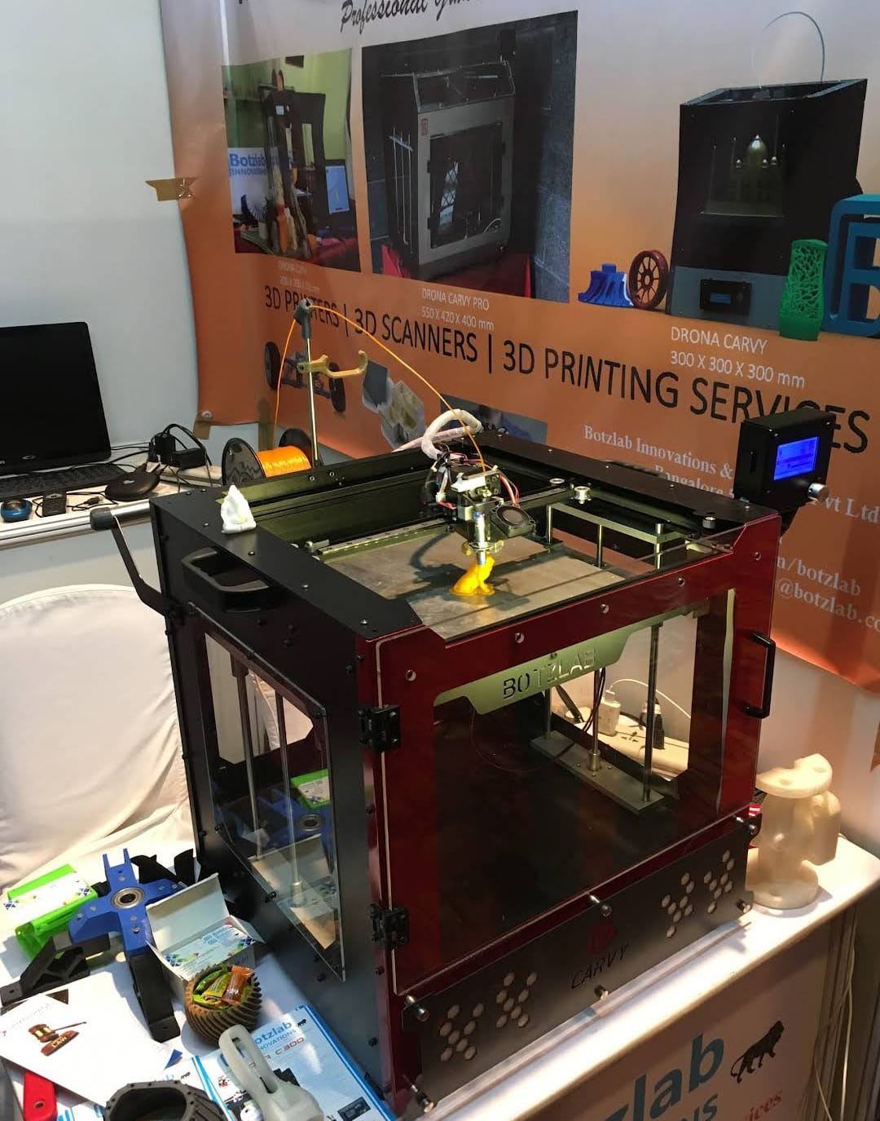
Specification
Specification of FDM
Build Volume | 260 x 260 x 260 mm
Layer Resolution | Down to 50 microns
Nozzle Diameter | 0.4 mm (Standard)
Max Nozzle Temperature | Up to 240°C
Max Bed Temperature | Up to 60°C
Print Speed | Up to 300 mm/s
Compatible materials | PEEK, Nylon, Carbon Fiber, PEKK, PETG, PLA, ABS.

Slide 12
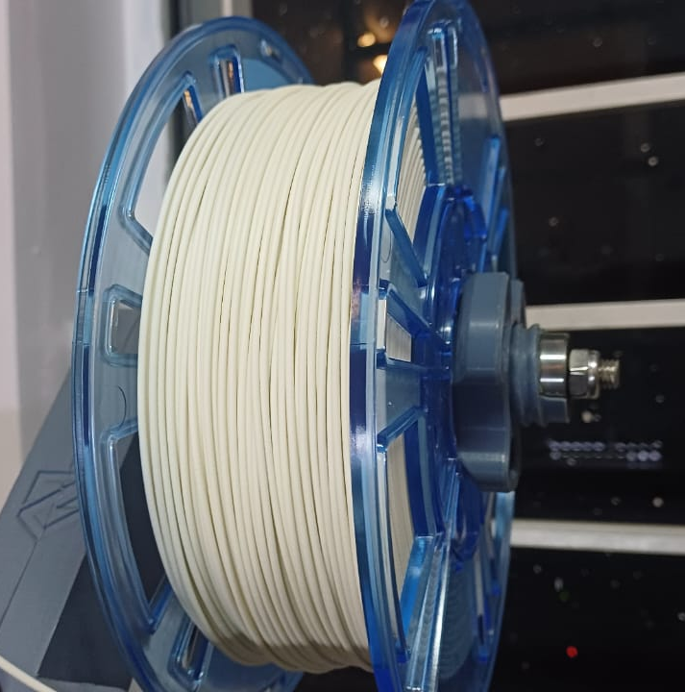
Specification of material: Polyethylene terephthalate glycol (PETG)
Chemical Structure | PETG belongs to the family of polyester. Chemical formula: C₁₄H₂₀O₅S.
Physical Properties | Density: 1.28 g/cm³ Melting Point: 220°C - 260°C Glass Transition Temperature (T_{g}): 80°C
Mechanical Properties | Tensile Strength: 50 Mpa. Flexural Strength: 74 Mpa. Hardness (Rockwell): 71 HRM
Thermal Properties | Thermal Conductivity: 0.162 – 0.225 W/m-K

Slide 13
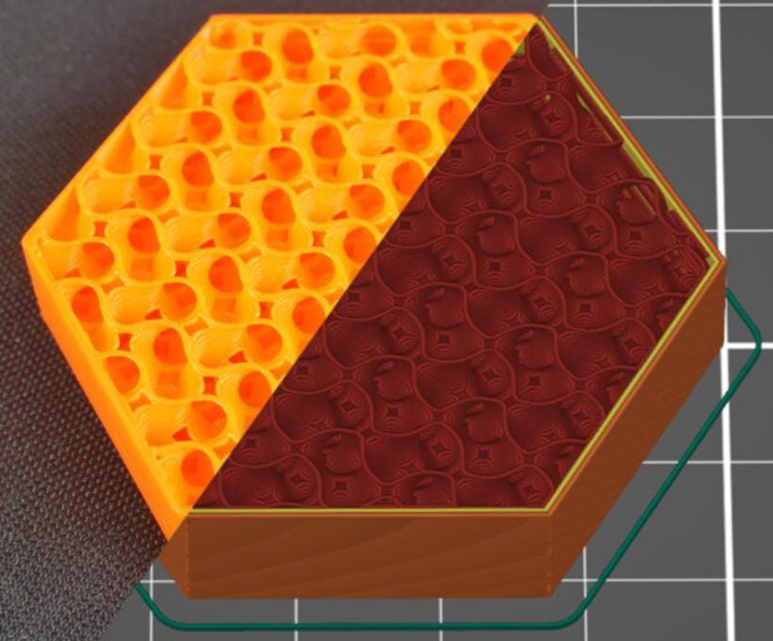
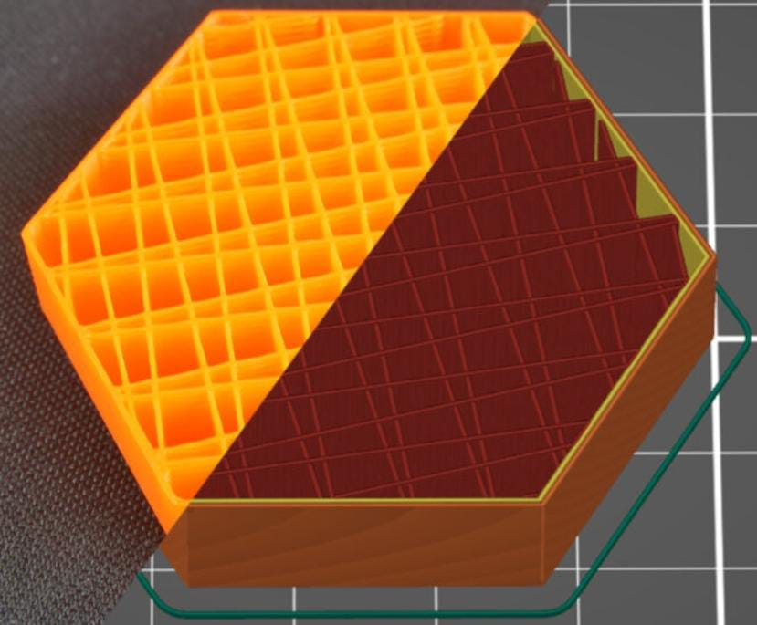
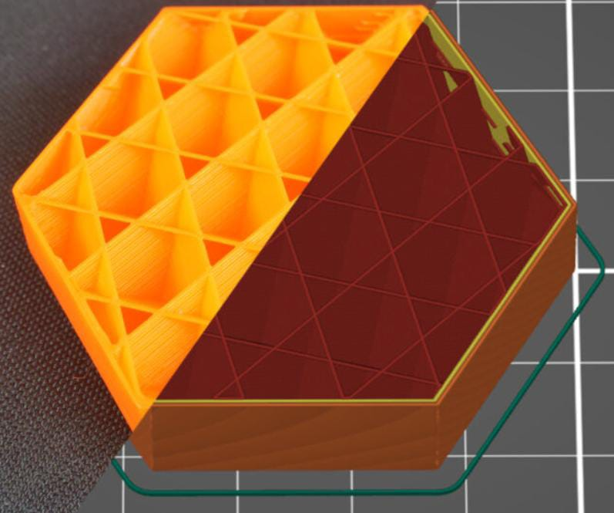
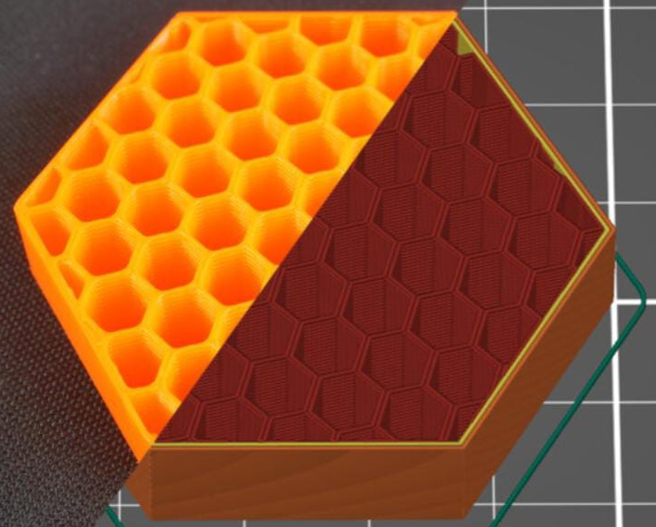
3 D Printing :
Input Variables -
Sl. No. | Parameters | Units | Level 1 | Level 2 | Level 3 | Level 4
A | Layer Thickness | mm | 0.15 | 0.2 | 0.25 | 0.3
B | Printing speed | mm/s | 30 | 40 | 50 | 60
C | Infill density | % | 15 | 30 | 45 | 60
D | Infill Pattern | - | Gyroid | Line | Support Cube | Honeycomb

Slide 14
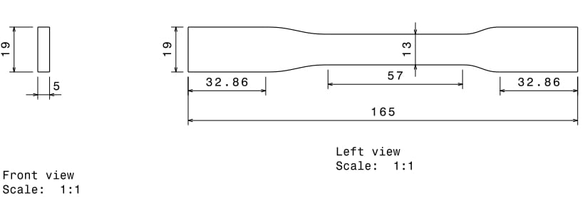
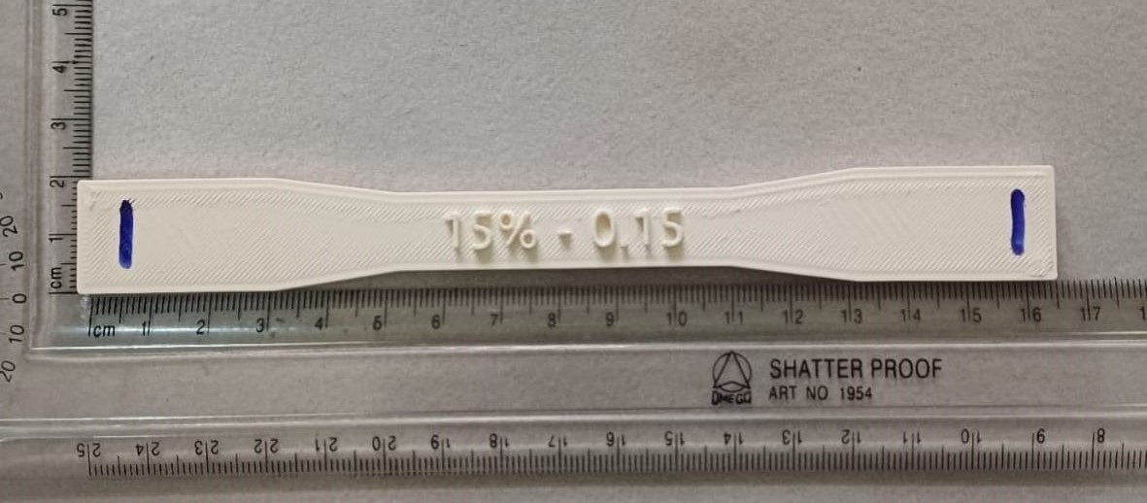
MODELING
Test Method | Method number
Tensile test | ASTM D638
Tensile Test Specimen
Sl. No. | Layer Thickness | Printing Speed | Infill Density | Infill Pattern
1 | 0.15 | 30 | 15 | Gyroid
2 | 0.15 | 40 | 30 | Support Cube
3 | 0.15 | 50 | 45 | Line
4 | 0.15 | 60 | 60 | Honeycomb
5 | 0.20 | 30 | 30 | Line
6 | 0.20 | 40 | 15 | Honeycomb
7 | 0.20 | 50 | 60 | Gyroid
8 | 0.20 | 60 | 45 | Support Cube
9 | 0.25 | 30 | 45 | Honeycomb
10 | 0.25 | 40 | 60 | Line
11 | 0.25 | 50 | 15 | Support Cube
12 | 0.25 | 60 | 30 | Gyroid
13 | 0.30 | 30 | 60 | Support Cube
14 | 0.30 | 40 | 45 | Gyroid
15 | 0.30 | 50 | 30 | Honeycomb
16 | 0.30 | 60 | 15 | Line

Slide 15
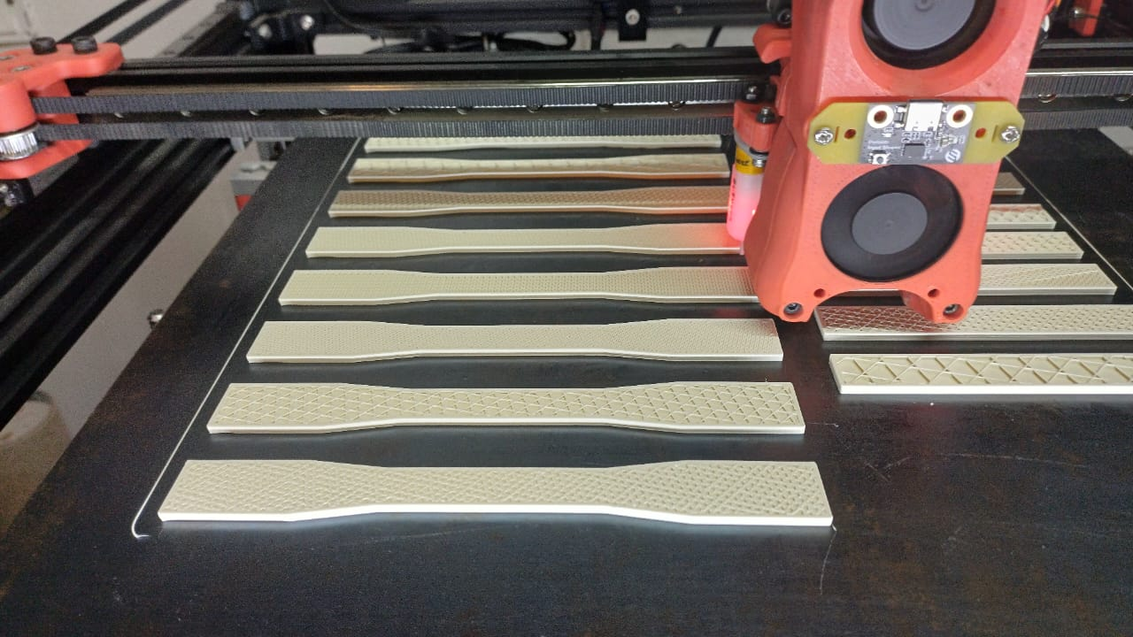
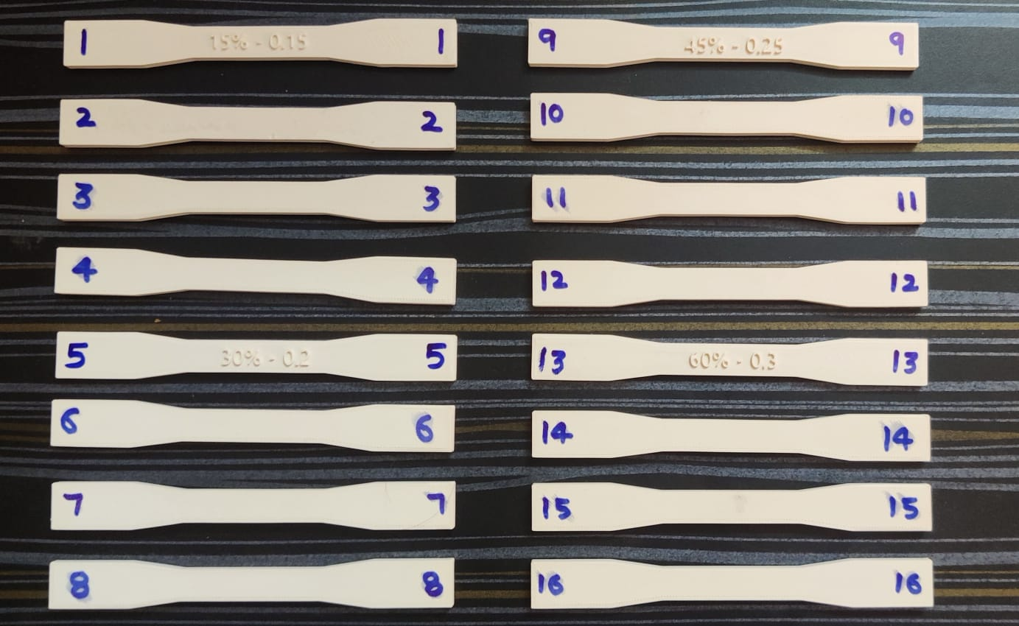
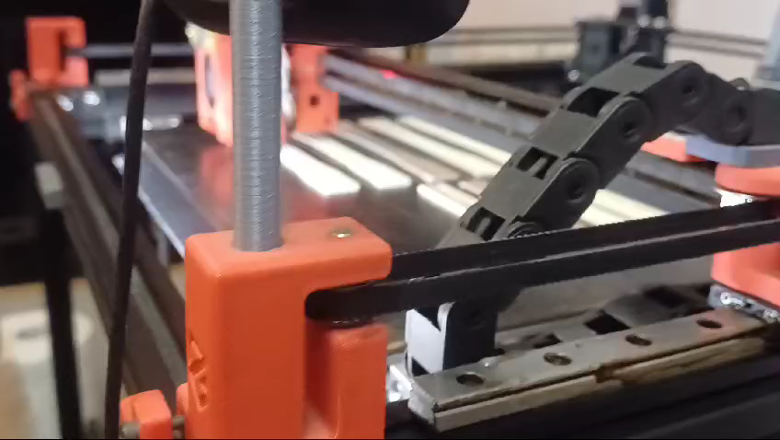

Slide 16
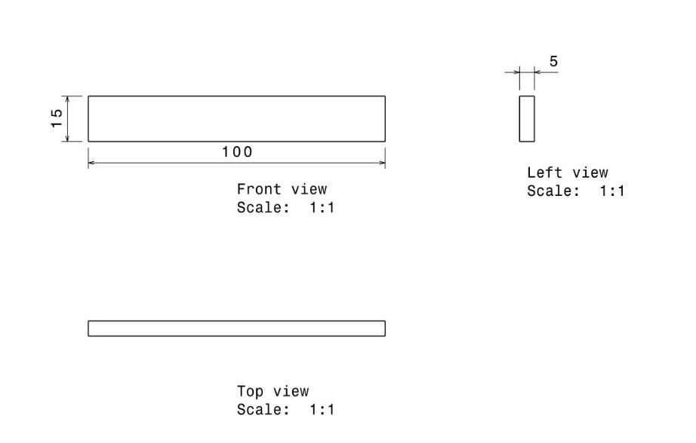
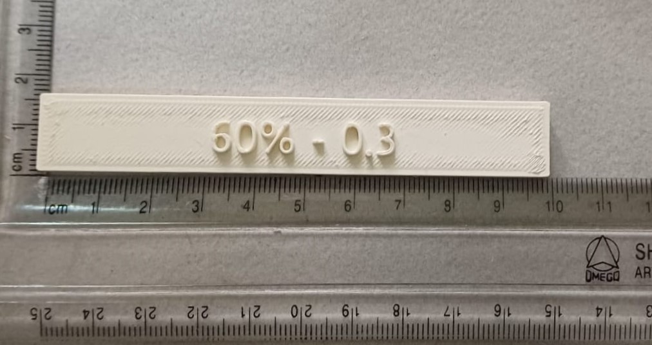
Flexural Test Specimen
Test Method | Method number
Flexural test | ASTM D7264
Sl. No. | Layer Thickness | Printing Speed | Infill Density | Infill Pattern
1 | 0.15 | 30 | 15 | Gyroid
2 | 0.15 | 40 | 30 | Support Cube
3 | 0.15 | 50 | 45 | Line
4 | 0.15 | 60 | 60 | Honeycomb
5 | 0.20 | 30 | 30 | Line
6 | 0.20 | 40 | 15 | Honeycomb
7 | 0.20 | 50 | 60 | Gyroid
8 | 0.20 | 60 | 45 | Support Cube
9 | 0.25 | 30 | 45 | Honeycomb
10 | 0.25 | 40 | 60 | Line
11 | 0.25 | 50 | 15 | Support Cube
12 | 0.25 | 60 | 30 | Gyroid
13 | 0.30 | 30 | 60 | Support Cube
14 | 0.30 | 40 | 45 | Gyroid
15 | 0.30 | 50 | 30 | Honeycomb
16 | 0.30 | 60 | 15 | Line

Slide 17
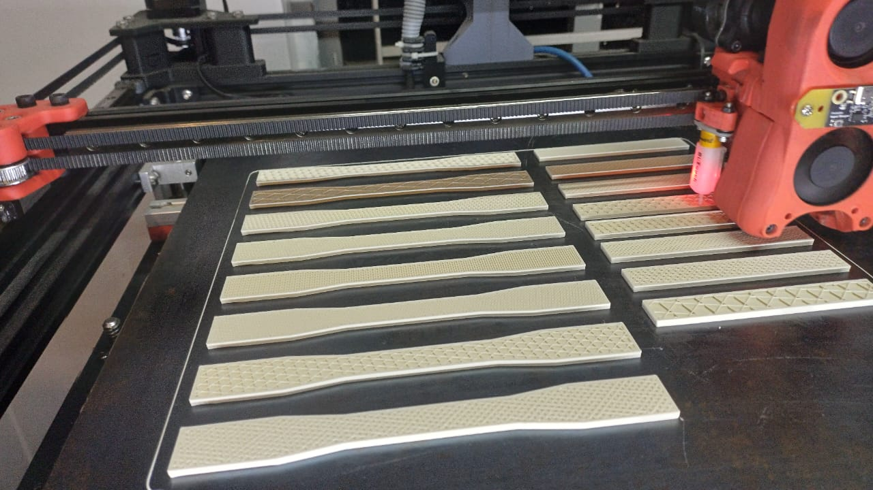
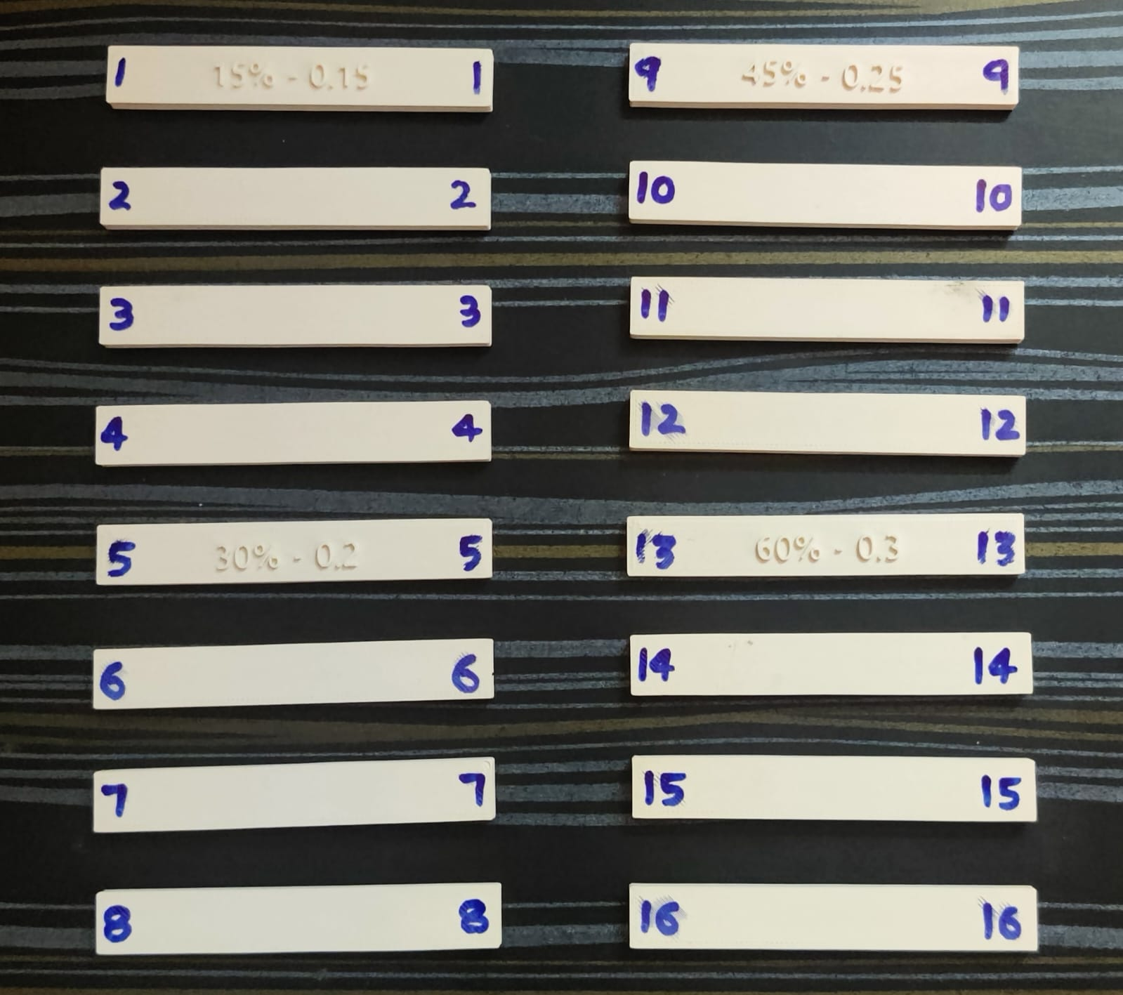
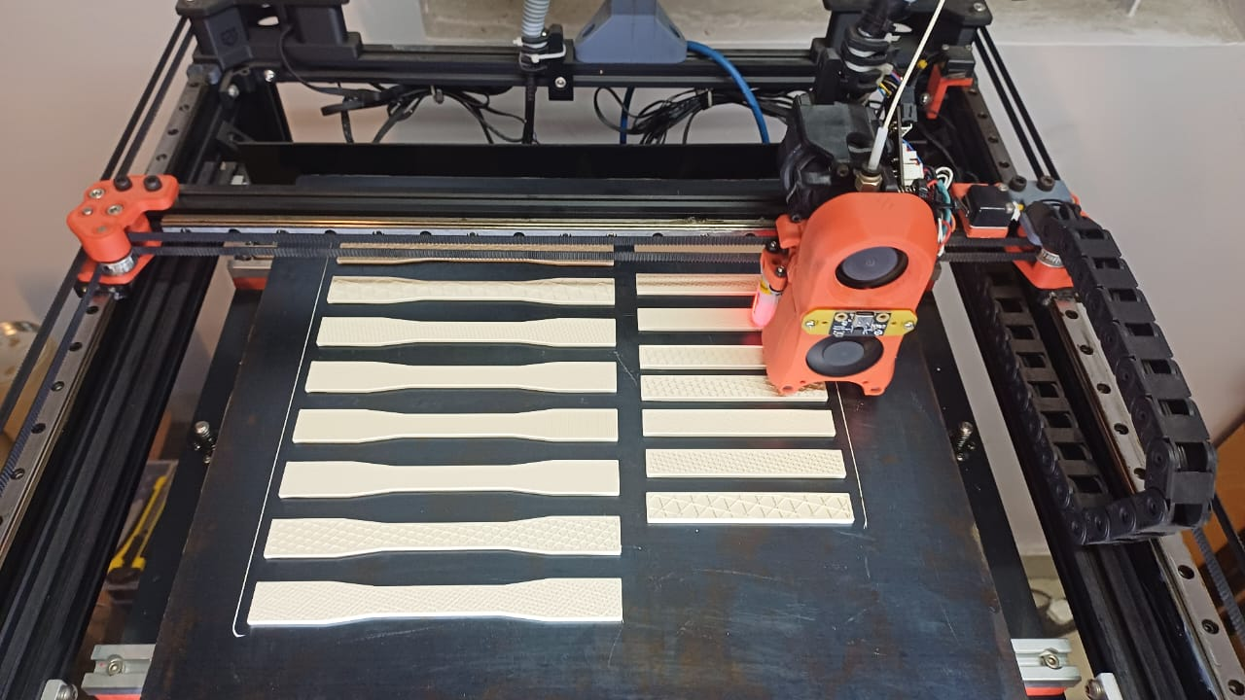

Slide 18
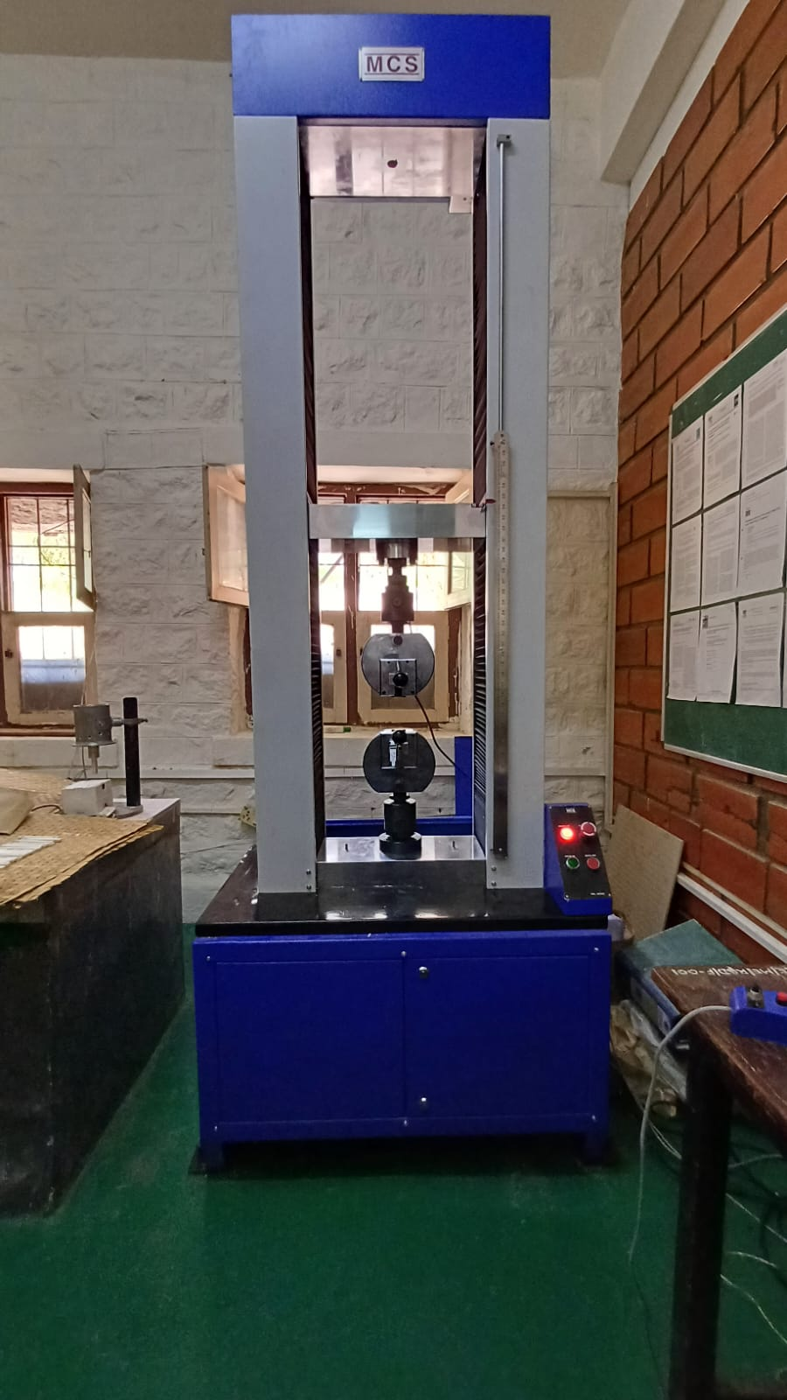
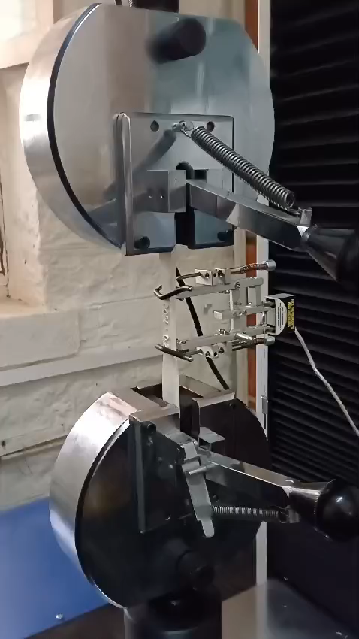
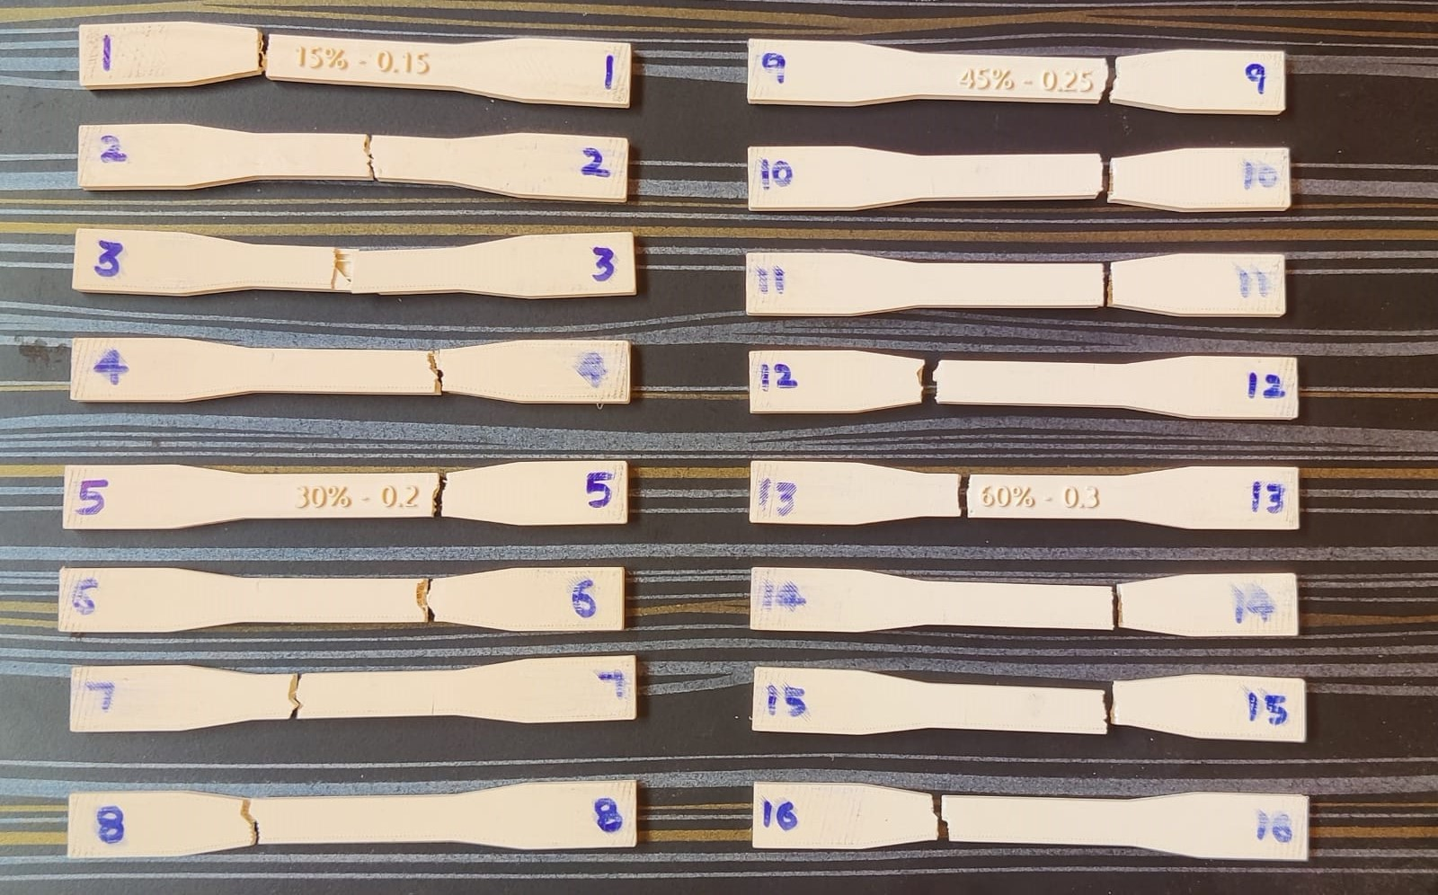
Experimentation
Tensile Test Specimen

Slide 19
Result of Tensile test
Sl. No. | Layer Thickness (mm) | Printing Speed (mm/s) | Infill Density (%) | Infill Pattern | Tensile Strength (N/mm²)
1 | 0.15 | 30 | 30 | Gyroid | 16.691
2 | 0.15 | 40 | 40 | Support Cube | 18.843
3 | 0.15 | 50 | 50 | Line | 20.613
4 | 0.15 | 60 | 60 | Honeycomb | 20.983
5 | 0.20 | 30 | 30 | Line | 18.122
6 | 0.20 | 40 | 15 | Honeycomb | 22.997
7 | 0.20 | 50 | 60 | Gyroid | 22.838
8 | 0.20 | 60 | 45 | Support Cube | 22.944
9 | 0.25 | 30 | 45 | Honeycomb | 25.170
10 | 0.25 | 40 | 60 | Line | 23.792
11 | 0.25 | 50 | 15 | Support Cube | 22.149
12 | 0.25 | 60 | 30 | Gyroid | 20.930
13 | 0.30 | 30 | 60 | Support Cube | 22.202
14 | 0.30 | 40 | 45 | Gyroid | 23.474
15 | 0.30 | 50 | 30 | Honeycomb | 24.481
16 | 0.30 | 60 | 15 | Line | 24.534

Slide 20
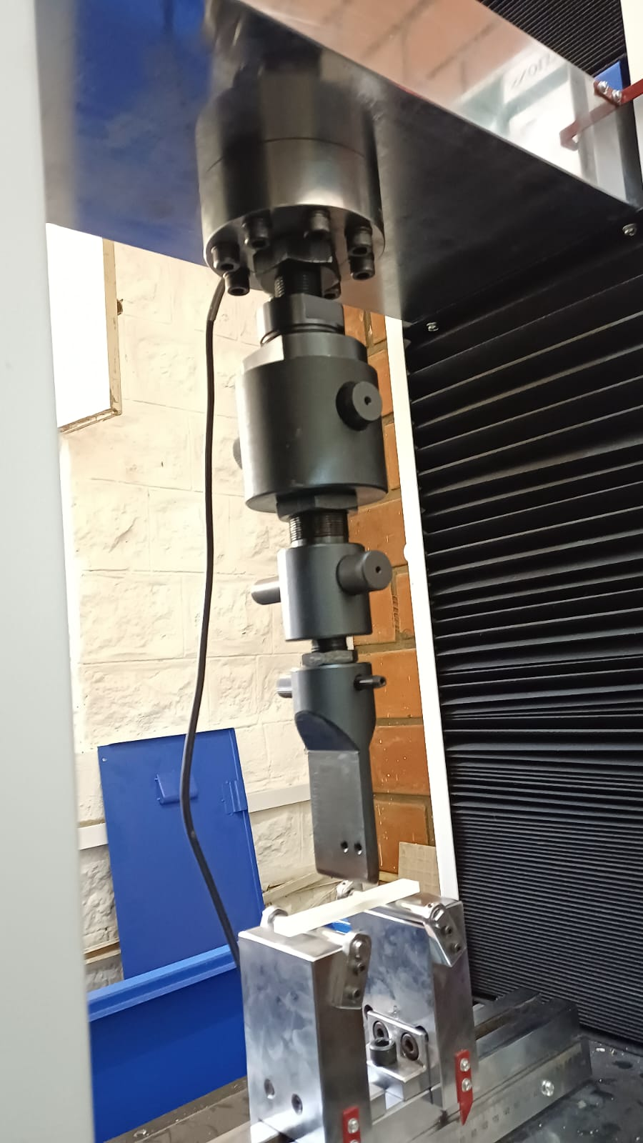
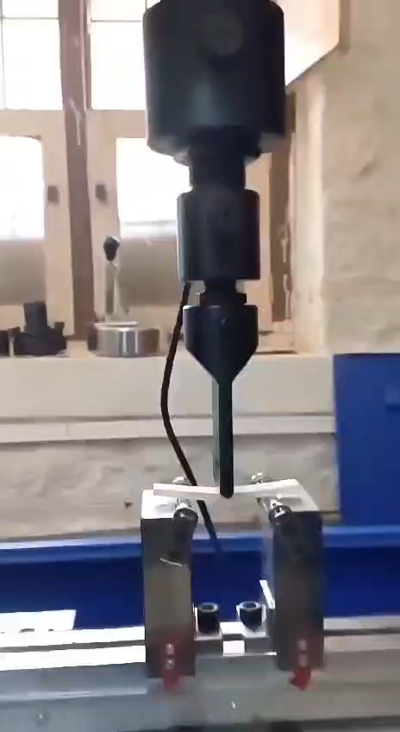
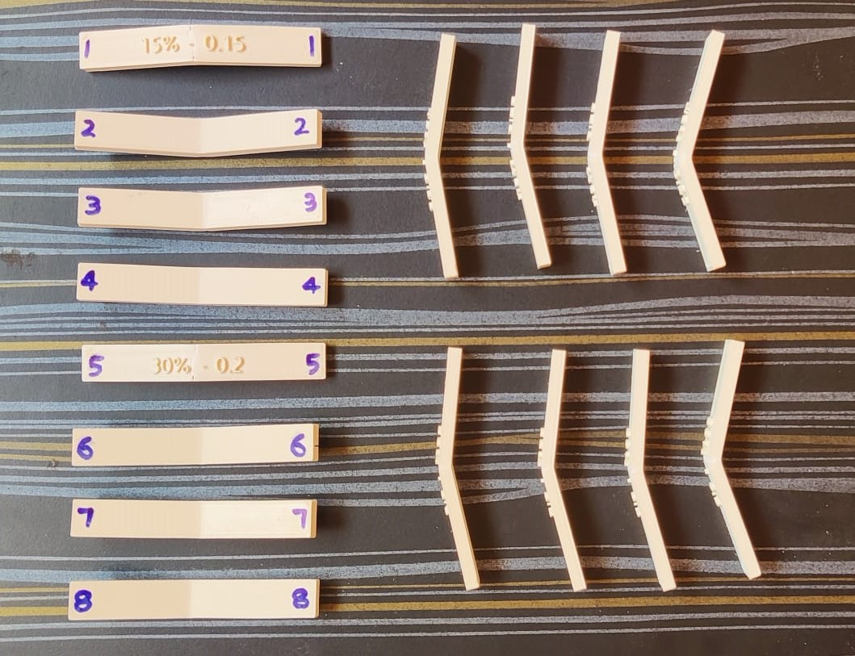
Flexural Test Specimen

Slide 21
Result of Flexural test
Sl. No. | Layer Thickness (mm) | Printing Speed (mm/s) | Infill Density (%) | Infill Pattern | Flexural Strength (N/mm²)
1 | 0.15 | 30 | 30 | Gyroid | 2.891
2 | 0.15 | 40 | 40 | Support Cube | 3.765
3 | 0.15 | 50 | 50 | Line | 3.967
4 | 0.15 | 60 | 60 | Honeycomb | 3.833
5 | 0.20 | 30 | 30 | Line | 3.967
6 | 0.20 | 40 | 15 | Honeycomb | 3.967
7 | 0.20 | 50 | 60 | Gyroid | 3.900
8 | 0.20 | 60 | 45 | Support Cube | 3.026
9 | 0.25 | 30 | 45 | Honeycomb | 3.967
10 | 0.25 | 40 | 60 | Line | 3.698
11 | 0.25 | 50 | 15 | Support Cube | 4.102
12 | 0.25 | 60 | 30 | Gyroid | 3.967
13 | 0.30 | 30 | 60 | Support Cube | 4.034
14 | 0.30 | 40 | 45 | Gyroid | 3.967
15 | 0.30 | 50 | 30 | Honeycomb | 3.967
16 | 0.30 | 60 | 15 | Line | 4.371

Slide 22
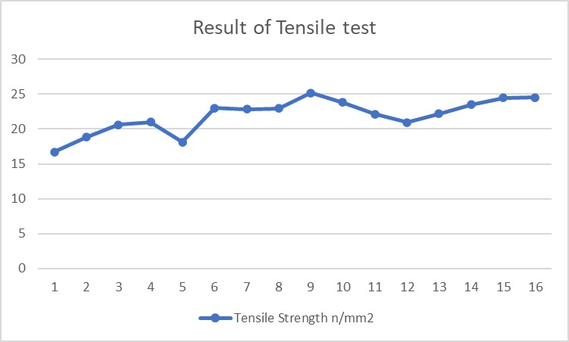
Results and Discussions
Tensile Specimen
Variation of experimental data
The data shows a gradual increase in tensile strength from lower values (16.691, 18.843) to higher values (24.534,25.170). This indicates a general trend of increasing strength. However, there are some fluctuations within this increasing trend. For example, there are instances where the tensile strength decreases slightly (e.g., 18.122 to 22.997) or increases significantly (e.g., 23.792 to 23.474). These variations suggest some level of measurement uncertainty or natural variation in the material's strength. Notably, there are a few instances where the tensile strength experiences significant jumps, such as from 22.944 to 23.792 or from 22.202 to 24.534. These larger variations could be attributed to factors like differences in testing conditions, or other external influences.

Slide 23
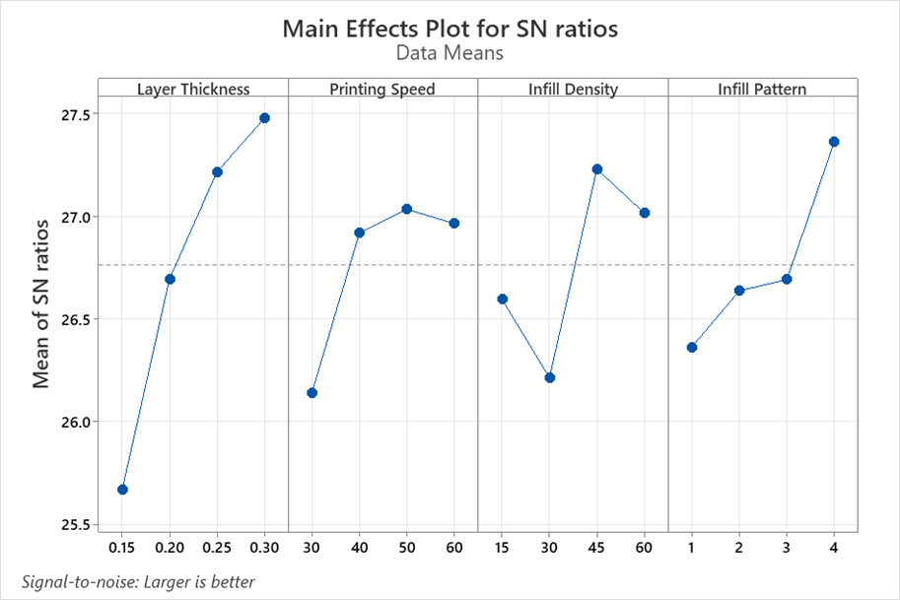
Response Table for Signal to Noise Ratios Taguchi Analysis: Tensile Strength N/mm2 versus Layer Thickness, Printing Speed, Infill Density, Infill Pattern
Level | Layer Thickness | Printing Speed | Infill Density | Infill Pattern
1 | 25.67 | 26.14 | 26.60 | 26.36
2 | 26.70 | 26.92 | 26.21 | 26.64
3 | 27.22 | 27.03 | 27.23 | 26.69
4 | 27.48 | 26.97 | 27.02 | 27.37
Delta | 1.81 | 0.90 | 1.02 | 1.00
Rank | 1 | 4 | 2 | 3

Slide 24
Regression Analysis: Tensile Strength N/mm2 versus Layer Thickness, Printing Speed, Infill Density, Infill Pattern Regression Equation Tensile Strength N/mm2 = 9.74 + 28.91 Layer Thickness + 0.0565 Printing Speed + 0.0336 Infill Density + 0.750 Infill Pattern
Coefficients
Term | Coef | SE Coef | T-Value | P-Value | VIF
Constant | 9.74 | 2.40 | 4.06 | 0.002
Layer Thickness | 28.91 | 6.51 | 4.44 | 0.001 | 1.00
Printing Speed | 0.0565 | 0.0326 | 1.73 | 0.111 | 1.00
Infill Density | 0.0336 | 0.0217 | 1.55 | 0.150 | 1.00
Infill Pattern | 0.750 | 0.326 | 2.30 | 0.042 | 1.00
Analysis of Variance
Source | DF | Adj SS | Adj MS | F-Value | P-Value
Regression | 4 | 64.516 | 16.129 | 7.60 | 0.003
Layer Thickness | 1 | 41.794 | 41.794 | 19.70 | 0.001
Printing Speed | 1 | 6.381 | 6.381 | 3.01 | 0.111
Infill Density | 1 | 5.079 | 5.079 | 2.39 | 0.150
Infill Pattern | 1 | 11.263 | 11.263 | 5.31 | 0.042
Error | 11 | 23.342 | 2.122
Total | 15 | 87.858
Model Summary
S | R-sq | R-sq(adj) | R-sq(pred)
1.45672 | 73.43% | 63.77% | 40.26%

Slide 25
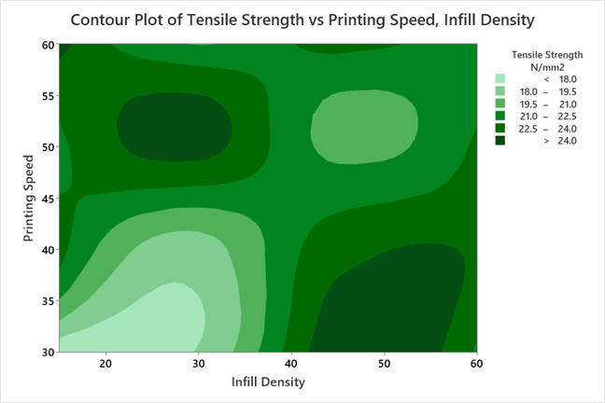
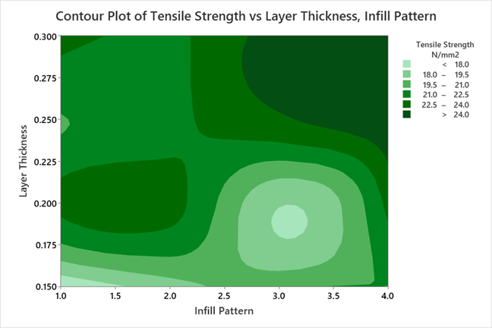
Tensile Strength Specimens Contour plots
Contour Plot of Tensile Strength N/mm2 vs Printing Speed vs Infill Density
Contour Plot of Tensile Strength N/mm2 vs Layer Thickness vs Infill Pattern
By considering Signal to noise ratio and contour plots we got the best input var are – [layer thickness-0.3, printing speed-50, Infill density-45, Infill pattern-Honeycomb]
Specimen number 15 is the best one in tensile strength among 16 specimen

Slide 26
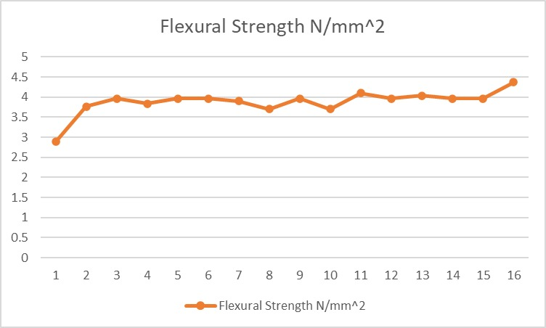
Flexural Test Specimen
Variation of experimental data
The data shows a range of flexural strength values, ranging from lower values (2.891,3.765) to higher values (3.967,4.371). This indicates a general range of flexural strength within the dataset. There are some fluctuations within the range. For example, there are instances where the flexural strength decreases slightly (e.g., 3.026 to 3.698) or increases gradually (e.g., 4.102 to 4.371). These variations suggest some level of measurement uncertainty or natural variation in the flexural strength values. Notably, there is a cluster of higher flexural strength values towards the upper end of the dataset (e.g., 4.371). These values indicate a higher level of strength compared to the rest of the dataset.

Slide 27
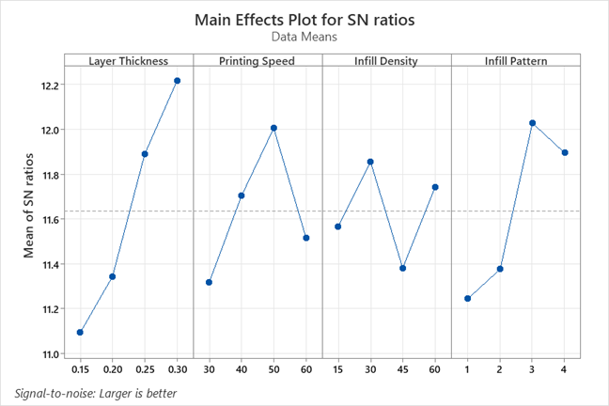
Response Table for Signal to Noise Ratios Taguchi Analysis: Flexural Strength N/mm2 versus Layer Thickness, Printing Speed, Infill Density, Infill Pattern
Level | Layer Thickness | Printing Speed | Infill Density | Infill Pattern
1 | 11.09 | 11.32 | 11.57 | 11.25
2 | 11.34 | 11.70 | 11.86 | 11.38
3 | 11.89 | 12.00 | 11.38 | 12.03
4 | 12.22 | 11.52 | 11.74 | 11.89
Delta | 1.12 | 0.69 | 0.47 | 0.78
Rank | 1 | 3 | 4 | 2

Slide 28
Regression Analysis: Flexural Strength N/mm2 versus Layer Thickness, Printing Speed, Infill Density, Infill Pattern
Regression Equation
Flexural Strength N/mm2 = 2.693 + 3.26 Layer Thickness + 0.00388 Printing Speed - 0.00056 Infill Density + 0.1026 Infill Pattern
Coefficients
Analysis of Variance
Term | Coef | SE Coef | T-Value | P-Value | VIF
Constant | 2.693 | 0.570 | 4.72 | 0.001
Layer Thickness | 3.26 | 1.55 | 2.11 | 0.059 | 1.00
Printing Speed | 0.00388 | 0.00775 | 0.50 | 0.626 | 1.00
Infill Density | -0.00056 | 0.00516 | -0.11 | 0.915 | 1.00
Infill Pattern | 0.1026 | 0.0775 | 1.32 | 0.212 | 1.00
Source | DF | Adj SS | Adj MS | F-Value | P-Value
Regression | 4 | 0.77387 | 0.193467 | 1.61 | 0.240
Layer Thickness | 1 | 0.53187 | 0.531869 | 4.43 | 0.059
Printing Speed | 1 | 0.03015 | 0.030148 | 0.25 | 0.626
Infill Density | 1 | 0.00142 | 0.001420 | 0.01 | 0.915
Infill Pattern | 1 | 0.21043 | 0.210433 | 1.75 | 0.212
Error | 11 | 1.31975 | 0.119977
Total | 15 | 2.09362
Model Summary
S | R-sq | R-sq(adj) | R-sq(pred)
0.346377 | 36.96% | 14.04% | 0.00%

Slide 29
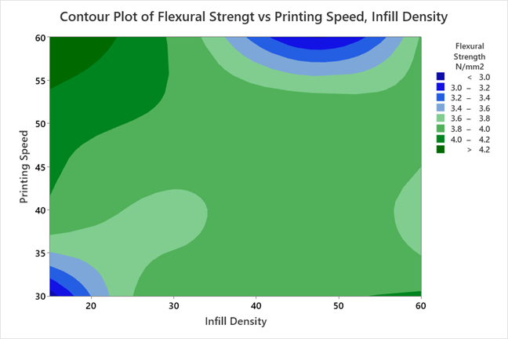
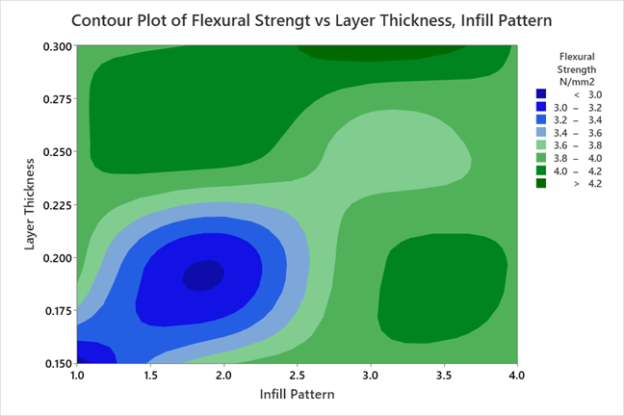
Flexural Strength Specimens Countour Plots
Contour Plot of Flexural Strength N/mm2 vs Printing Speed vs Infill Density
Contour Plot of Flexural Strength N/mm2 vs Layer Thickness vs Infill Pattern
By considering Signal to noise ratio and contour plots we got the best input var are – [layer thickness-0.25, printing speed-50, Infill density-30, Infill pattern-Support Cube]
Specimen number 15 is the best one in tensile strength among 16 specimen

Slide 30
Total cost of the Project
Sl. NO. |  | Qty. | AMOUNT
1. | PETG Filament | 500gm | 11,000
2. | 3 - D Printing Machine | - | 5,000
3. | Other Requirement | - | 4,000
 | Total |  | ₹ 20,000

Slide 31
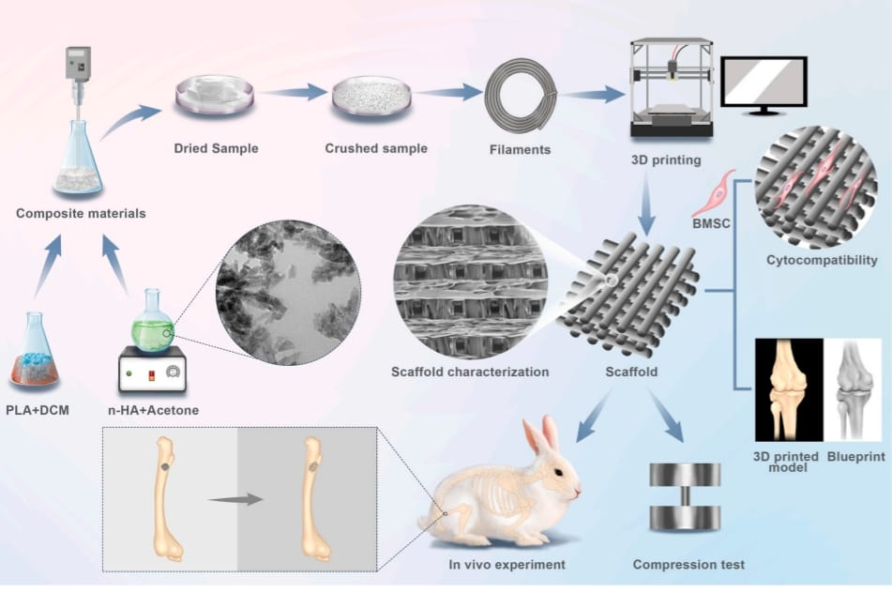
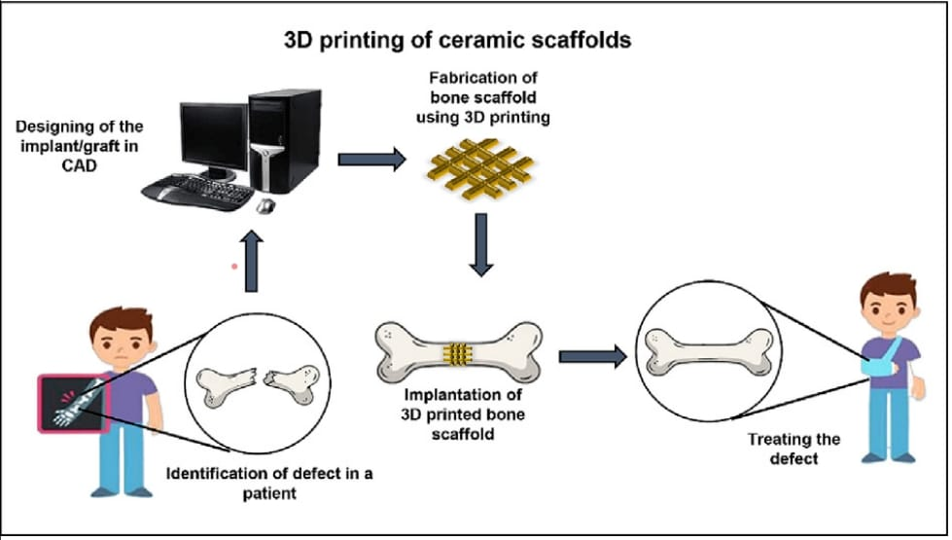
Applications:
Patient-Specific Implants.
Orthopaedic Implants.
Trauma Surgery.
Research and Development.
Customized Surgical Guides.

Slide 32
Project outcomes
Improved tensile strength, flexural strength, of the 3D printed PETG materials.
Detailed documentation of the optimized FDM parameters and characterization results.
Materials specifically tailored for biomedical applications, addressing the unique requirements of the healthcare industry.
The optimization and characterization of FDM parameters for 3D printed material for Biomedical application aim to achieve superior mechanical properties, biocompatibility, and cost-effectiveness, ultimately advancing the field of additive manufacturing in the biomedical industry.

Slide 33
References
[1] Balwant Singh, Raman Kumar, “Polymer matrix composites in 3D printing: A state of art review” https://doi.org/10.1016/j.matpr.2020.04.335
[2] Xin Wang, Man Jiang, “3D printing of polymer matrix composites: A review and prospective”
https://doi.org/10.1016/j.compositesb.2016.11.034
[3] Yahia Halabi, “Optimizing the material and printing parameters of the additively manufactured fiber-reinforced polymer composites using an artificial neural network model and artificial bee colony algorithm”
https://doi.org/10.1016/j.istruc.2022.10.134
[4] Muammel M. Hanon, “The influence of 3D printing process parameters on the mechanical performance of PLA polymer and its correlation with hardness” https://www.elsevier.com/locate/jmbbm
[5] Christine Le, “Experimental and numerical investigation of 3D-Printed bone plates under four-point bending load utilizing machine learning techniques” www.elsevier.com/locate/jmbbm
[6] Wenzhao Wang, “3D printing of PLA/n-HA composite scaffolds with customized mechanical properties and biological functions for bone tissue engineering” www.elsevier.com/locate/jmbbm
[7] Imran Khan, “Parametric investigation and optimization of mechanical properties of thick tri-material based composite of PLA-PETG-ABS 3D-printed using fused filament fabrication” http://www.sciencedirect.com/journal/composites-part-c-open-access

Slide 34

THANK YOU

